Slide 1
Flags and Countries of the British empire in 1914
Chotto Xenos Resources
Akram Khan Company

Slide 2
This PDF includes modern day flags of countries that were part of the British Empire in 1914. Both the modern day and 1914 name of the country has been included.

Slide 3
India (formally included Pakistan and Bangladesh)

Slide 4
Pakistan (formally India)

Slide 5
Bangladesh (formally India)

Slide 6
Sri Lanka (formally Ceylon)

Slide 7
Egypt

Slide 8
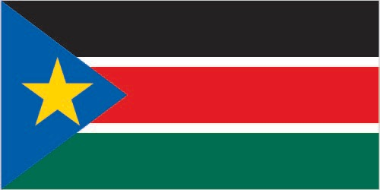
Sudan and South Sudan (formally Sudan)
Sudan
South Sudan

Slide 9
Zimbabwe (formally Rhodesia)

Slide 10
Australia

Slide 11
New Zealand

Slide 12
Canada (including Newfoundland)

Slide 13
Jamaica

Slide 14
Trinidad and Tobago

Slide 15
Barbados

Slide 16
Bahamas

Slide 17
Grenada

Slide 18
Guyana (formally British Guyana)

Slide 19
St Lucia

Slide 20
St Vincent

Slide 21
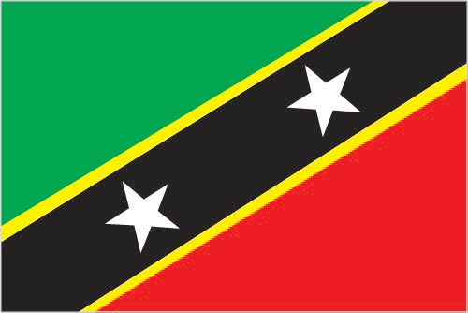
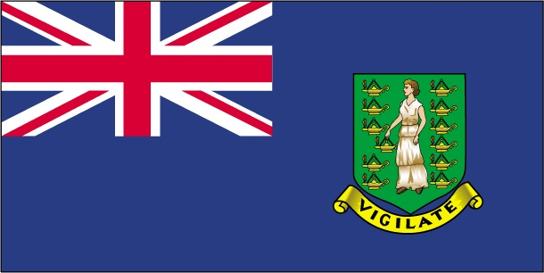
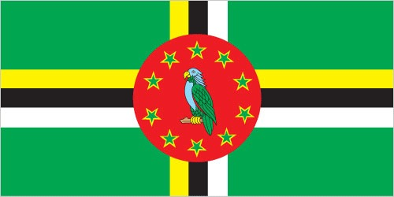
Leeward Islands (formally included Dominica)
Antigua and Barbuda
St Kitts and Nevis
Montserrat
Dominica
British Virgin Islands

Slide 22
Belize (formally British Honduras)

Slide 23
Nigeria

Slide 24
Ghana (formally the Gold Coast)

Slide 25
Sierra Leone

Slide 26
Kenya

Slide 27
Uganda

Slide 28
Malawi (formally Nysaland)

Slide 29
South Africa

